Slide 1
REAL
Create Job Posting: Cheat Sheet
ROLLINS EARN AND LEARN

Slide 2
RSPH Career Connection powered by 12Twenty
https://sph-emory.12twenty.com/hire

Slide 3
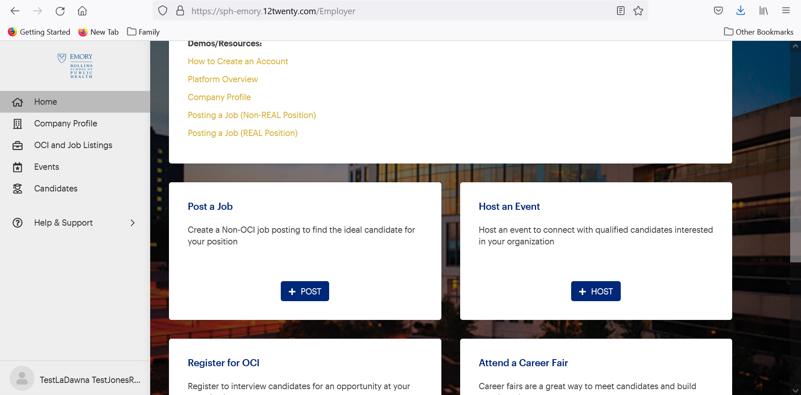
To Post a Job: Method 1
Click here

Slide 4
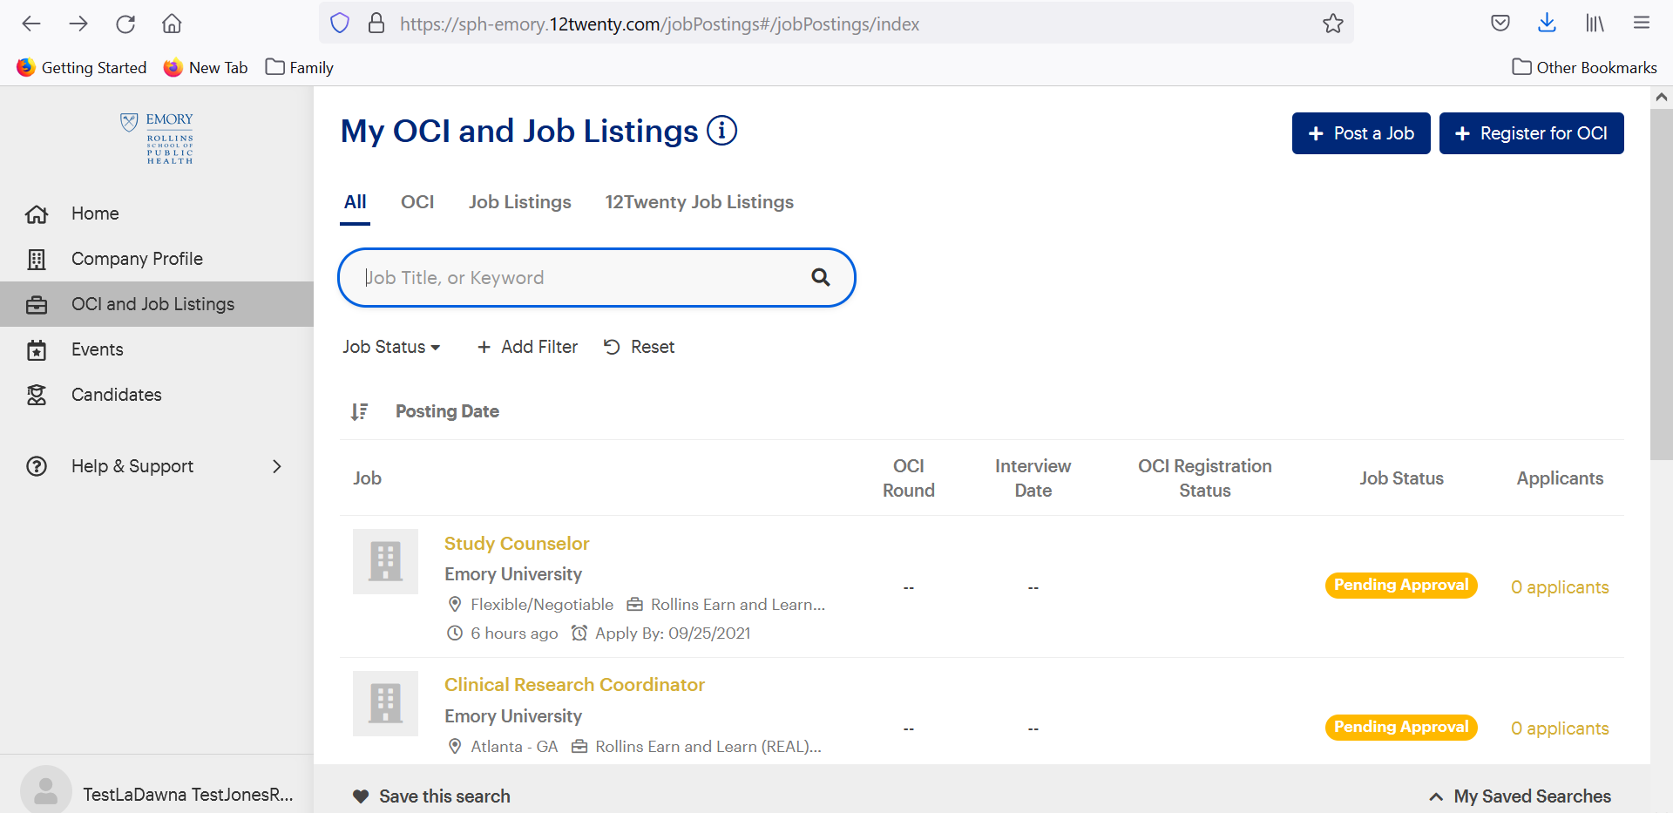
To Post a Job: Method 2
Click here

Slide 5
Job Details
Field Name | Required | Instructions
Employer | Yes | Auto populated
Type of Job | Yes | Select “Rollins Earn and Learn (REAL) Position” ONLY
Location Type | Yes | Select most appropriate option based on work location
Location | Yes | Remote & Flexible: N/A Spec Loc: Enter Country & City/State
Pref Yrs of Exp | No | Only enter # of years if this is required for the job
Interview Format | No | If you’d like to provide those details, select from the options

Slide 6
Job Details cont’d
Field Name | Required | Instructions
Work Auth Req | Yes | Select “All Work Authorizations Accepted”
Resume Collect | No | Skip this field
Industry | Yes | Please select the most appropriate option based on the industry your employer identifies
Public Health Competencies | Yes | You must select 1-2 of the 22 PH Competencies

Slide 7
Application Method(s)
Field Name | Required | Instructions
Apply via This Site | Yes | Select “Yes”
Apply via External Link | No | Leave blank or select the option you’d like
Apply via Email | No | Leave blank or select the option you’d like

Slide 8
Job Description
Field Name | Required | Instructions
Job Description | Yes | Should be detailed and describe the role and responsibilities of the position to attract the best candidates

Slide 9
Attachments
Field Name | Required | Instructions
Attachments | No | If you’d like to include any attachments with the job post you can add them in this section

Slide 10
Application Document Requirements
Field Name | Required | Instructions
Resume | Yes | Automatically required
Add “Other” | Yes | Label this document as “REAL Award Letter”
Note: Add any other documents you’d like to collect when students apply for the position you’re posting.

Slide 11
Job Dates
Field Name | Required | Instructions
Application Begins On | Yes | No earlier than August 1, 2021
Application Deadline | Yes | Oct 1, 2021
Anticipated Job Start Date | No | Leave blank or if you have a date you’re welcome to add
For Immediate Hire | No | Leave blank or select “Yes” or “No” based on your preference

Slide 12
Primary Job Contact
Note: If you are the “Primary Contact” please click the grey button labeled “Use My Information” to have most of the information in this section completed for you.
Field Name | Required | Instructions
Name | Yes | Enter the your/primary contact name
Title | Yes | Enter the your/primary contact title
Email | Yes | Enter the your/primary contact email
Phone | Yes | Enter the your/primary contact phone number
Address | Yes | Enter the your/primary contact physical address
RSPH Alumnus | Yes | Select most appropriate option
Emory Alumnus | Yes | Select most appropriate option

Slide 13
Eligibility
Field Name | Required | Instructions
Student Group | Yes | **ONLY select “REAL”
Degree | No | Leave blank
Minimum GPA | No | Leave blank

Slide 14
Finished
Click “Save Draft” if you’re not ready to submit
Click “Submit” if you’re ready to submit it for review and approval
Postings are approved within 48-business hours

Slide 15
Thank you for your partnership! real@emory.edu

